Slide 1
Natural Language Processing
Thapar Summer School 2023

Slide 2
What is Natural Language Processing(NLP)?
Natural Language Processing (NLP) is a field at the intersection of computer science, artificial intelligence, and linguistics. The goal is for computers to process or “understand” natural language to perform tasks like Language Translation and Question Answering.
NLP is the technique that enables the machines to interpret and to understand the way humans communicate.

Slide 3
Why study NLP?
There’s a fast-growing collection of useful applications derived from this field of study. They range from simple to complex. Below are a few of them:
Spell Checking, Keyword Search, Finding Synonyms.
Extracting information from websites such as product price, dates, location, people, or company names.
Classifying: reading level of school texts, positive/negative sentiment of longer documents.
Machine Translation.
Spoken Dialog Systems.
Complex Question Answering.

Slide 4
Data Cleaning
Remove stop-words: There are a few words which are very commonly used when humans interact, but these words don’t make any sense or add any extra value. Additionally, there might be few words which are not required for the business case given in hand. So, these words need to be deleted from the data.
Make lower case: This is required to make all the words in lowercase just to maintain the uniformity.
Lemmatization: This helps to reduce the words into a single form.
Stemming: This helps to reduce the words into their root form.

Slide 5
Data Cleaning
Removal of regular expressions: Regular expression helps to identify and to get rid of different patterns which are not required in the text.
Parts-of-Speech (POS) tagging: This helps to identify the parts of speech. Based on the use case one can keep or remove some of them.

Slide 6
Tokenization
This is one of the common practices while working on text data. This helps to split a phrase, sentence, or paragraph into small units like words or terms. Each unit is called a token.
Tokenization using split () function: Returns list of strings after breaking the given string by the specified separator.
Tokenization using Regular expression: Returns list based on the regular expressions.
Tokenization using NLTK: There are different types of tokenizers under NLTK package like word tokenizer (word_tokenize), regex tokenizer (RegexpTokenizer), whitespace tokenizer (WhitespaceTokenizer)

Slide 7
N-Gram
N-gram is a collection of n successive items in a text document that may include words, numbers, symbols, and punctuation. N-gram models are useful in many text analytics applications where sequences of words are relevant, such as in sentiment analysis, text classification, and text generation.

Slide 8
Vectorization
Vectorization helps to map the words to a vector of real numbers, which further helps into predictions. This helps to extract the important features.
Techniques:
CountVec: Count number of times a particular word appears in the document. CountVectorizer helps to get this count.
TF-IDF: Term frequency Inverse document frequency (TF-IDF) provides an overall weightage of a word in the document. TfidfVectorizer helps to get this weighted score.

Slide 9
Machine Translation
Machine Translation is the classic test of language understanding. It consists of both language analysis and language generation. In a traditional Machine Translation system, we have to use parallel corpus — a collection of texts, each of which is translated into one or more other languages than the original.
Neural Machine Translation is the approach of modelling this entire process via one big artificial neural network, known as a Recurrent Neural Network(RNN).

Slide 10
Recurrent Neural Networks(RNN)
RNNs are called recurrent because they perform the same task for every element of a sequence, with the output being depended on the previous computations.
Types of RNN’s:-
One To One: There is only one pair here. A one-to-one architecture is used in traditional neural networks.
One To Many: A single input in a one-to-many network might result in numerous outputs. One too many networks are used in the production of music, for example.
Many To One: In this scenario, a single output is produced by combining many inputs from distinct time steps. Sentiment analysis and emotion identification use such networks, in which the class label is determined by a sequence of words.
Many To Many: For many to many, there are numerous options. Two inputs yield three outputs. Machine translation systems, such as English to French or vice versa translation systems, use many to many networks.

Slide 11

How does Recurrent Neural Networks work?
The input layer x receives and processes the neural network’s input before passing it on to the middle layer.
Multiple hidden layers can be found in the middle layer h, each with its own activation functions, weights, and biases. You can utilize a recurrent neural network if the various parameters of different hidden layers are not impacted by the preceding layer, i.e. There is no memory in the neural network.
The different activation functions, weights, and biases will be standardized by the Recurrent Neural Network, ensuring that each hidden layer has the same characteristics. Rather than constructing numerous hidden layers, it will create only one and loop over it as many times as necessary.

Slide 12
Embedding Layer
In a recurrent neural network (RNN), the embedding layer is commonly used to convert input sequences of discrete tokens into dense, continuous vectors. The embedding layer maps each token to a lower-dimensional vector representation, allowing the network to learn meaningful relationships between the tokens.

Slide 13
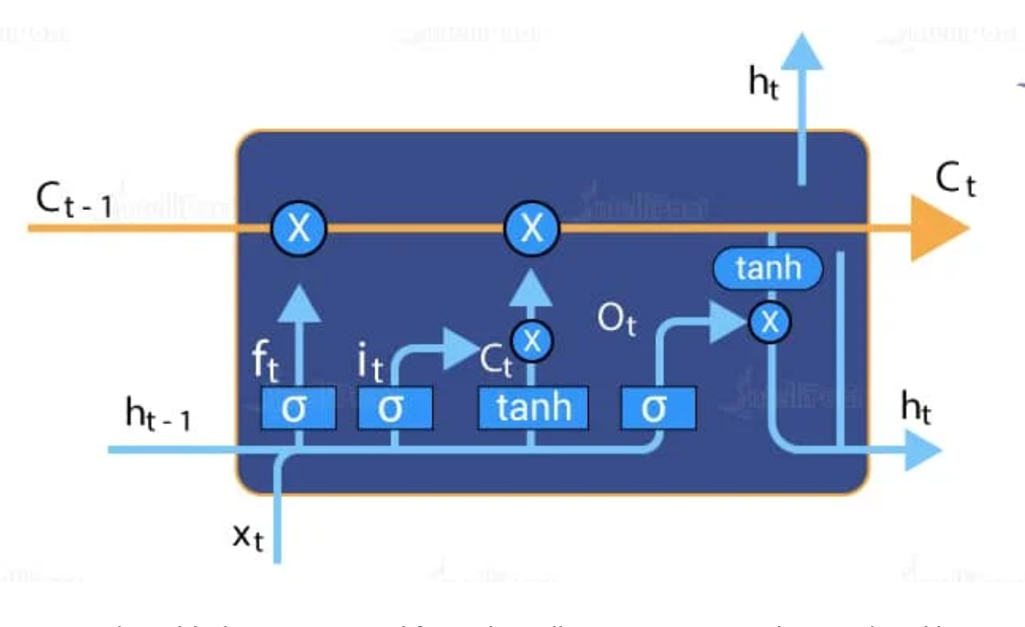
Long Short Term Memory (LSTM)
The central role of an LSTM model is held by a memory cell known as a ‘cell state’ that maintains its state over time. The cell state is the horizontal line that runs through the top of the below diagram. It can be visualized as a conveyor belt through which information just flows, unchanged.
Information can be added to or removed from the cell state in LSTM and is regulated by gates. These gates optionally let the information flow in and out of the cell.

Slide 14
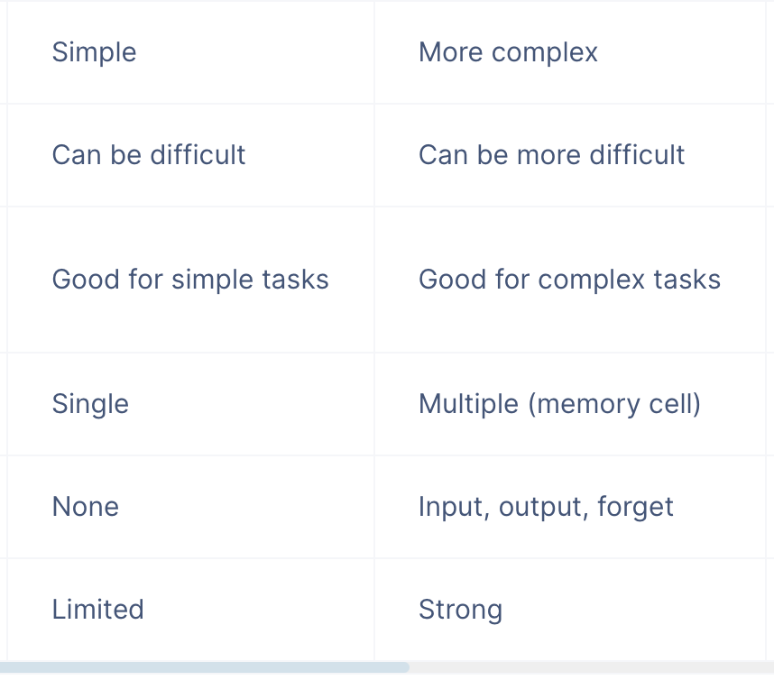
LSTM VS RNN

